Slide 1
Two-Dimensional Learning Rate Decay: Towards Accurate Federated Learning with Non-identically and independently distributed Data
Authors: Kaiwei Mo, Chen Chen, Jiamin Li, Henry Xu* and Chun Jason Xue
Contact: kaimo6-c@my.cityu.edu.hk
May, 2021

Slide 2
Federated learning, mini-batch gradient descent (Background)
Non-iid data, Accuracy loss analysis (Motivation)
Adaptive learning rate tuning (Algorithm)
Performance evaluation (Evaluation)

Slide 3



Background
federated learning
server
limited communication bandwidth
ω
ω
data
......
client
client
client
client
data privacy

Slide 4

Background
mini-batch gd
(1)
ω: model parameters
s: data sample
|D|: number of samples in the dataset
f(s,ω): loss function

Slide 5
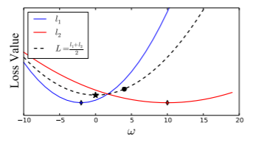
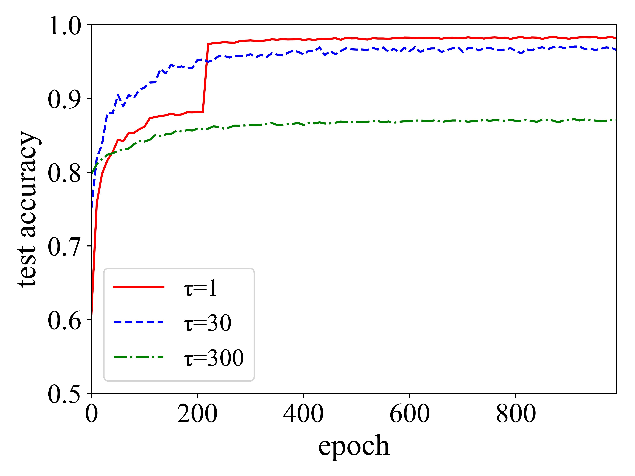
Motivation
non-iid data
Fig1: The Average point (circle point) diverges from the true optima (star point).
Fig2: Accuracy changes when the synchronization frequency (τ) changes.

Slide 6
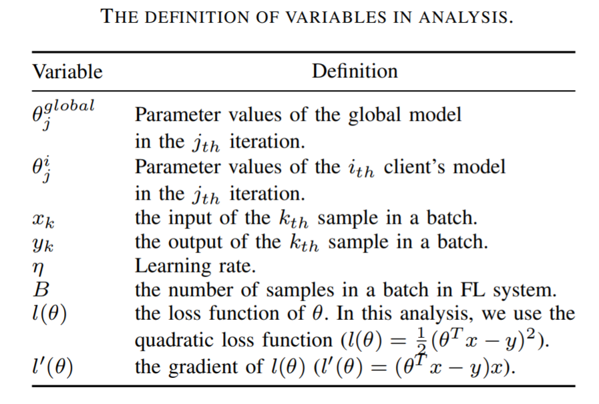
Motivation
analysis (theoretical)

Slide 7
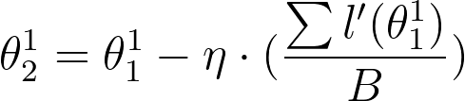
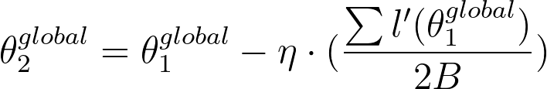
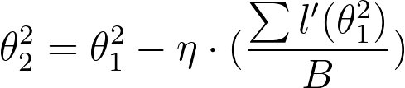

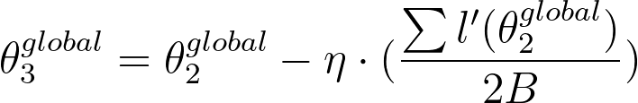
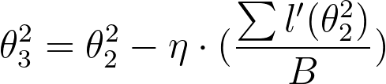
Motivation
analysis (theoretical)
 | FL mode | standalone mode
1st iteration | client1: (2) client2: (2) | (4)
2nd iteration | client1: (3) client2: (3) | (5)

Slide 8

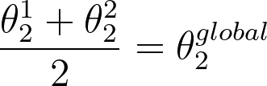
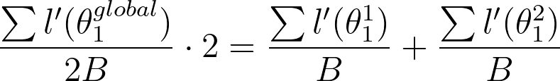
Motivation
analysis (theoretical)
same initialization:
(6)
+ eq(2), (4)
(8)
1st iteration
(7)

Slide 9
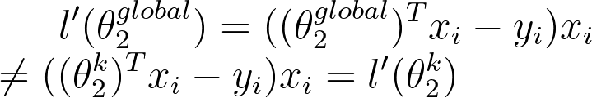

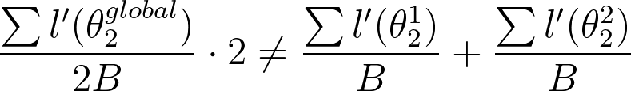
Motivation
analysis (theoretical)
(9)
(11)
2nd iteration
(10)
+ eq (3), (5)

Slide 10
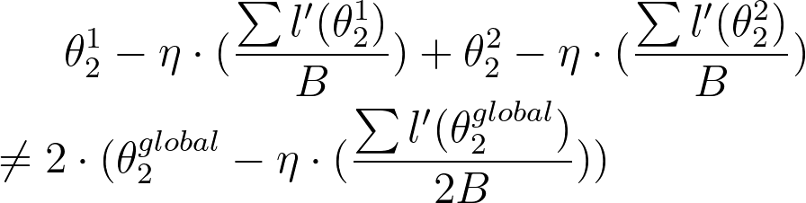
Motivation
analysis (theoretical)
(12)

Slide 11
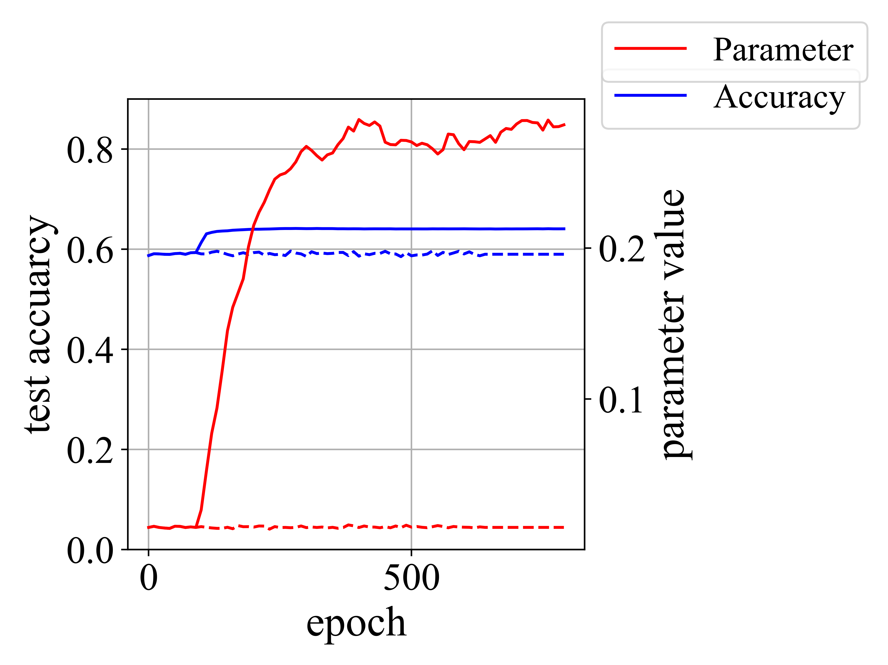
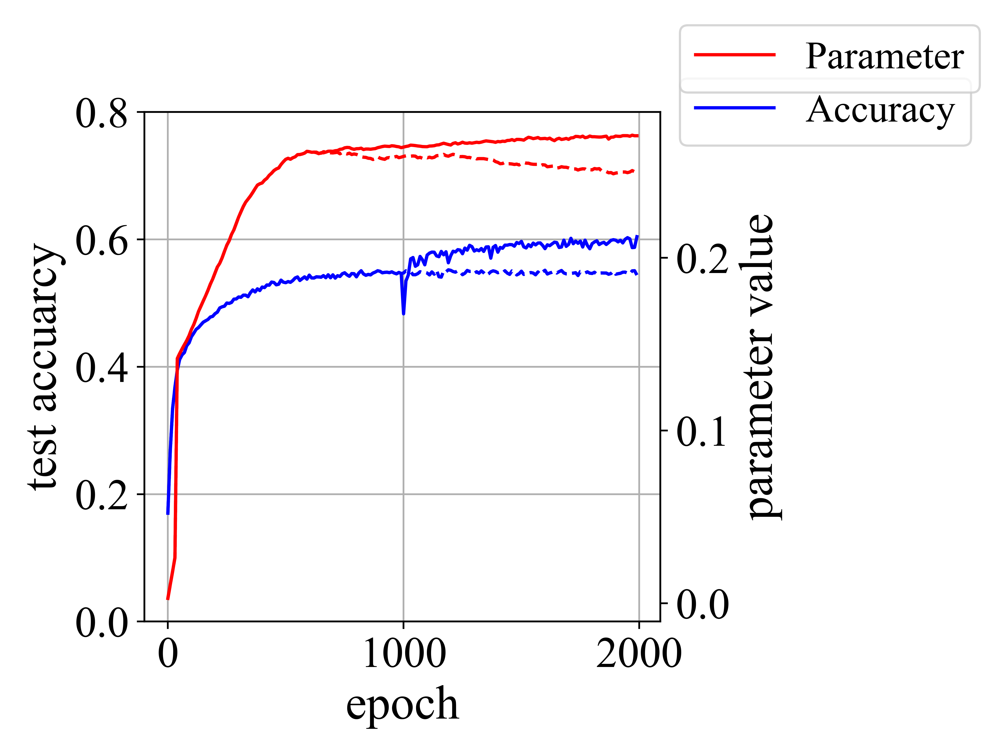
Motivation
analysis (experimental)
(a) SVM, tuning at epoch 100.
(b) LeNet-5, tuning at epoch 1000.
Fig. 2

Slide 12
Algorithm
Q1: When to tune the learning rate?
Q2: How to tune the learning rate?

Slide 13
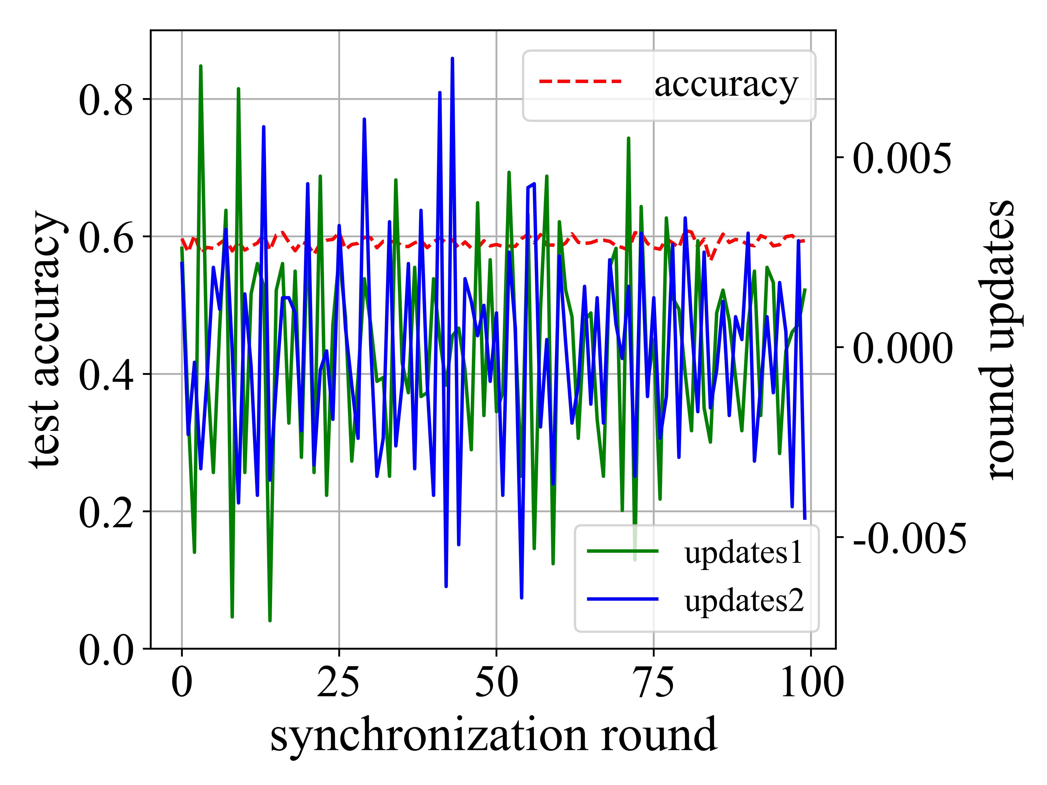
Algorithm
Q1
Fig.3 Two round grdients in SVM. When the model converges, the updates of adjacent rounds are mostly in the opposite direction.

Slide 14
Alogorithm
Q1
Every synchronization round:
sum <- sum + round_gradient_{r}*round_gradient_{r-1};
if round_id > observation_window + last_round_id and sum < 0:
decrease_times <- decrease_times + 1;
sum <- 0;
last_round_id <- round_id;

Slide 15

Algorithm
Q2
(13)
iteration-dimension
round-dimension
multiply with init lr

Slide 16
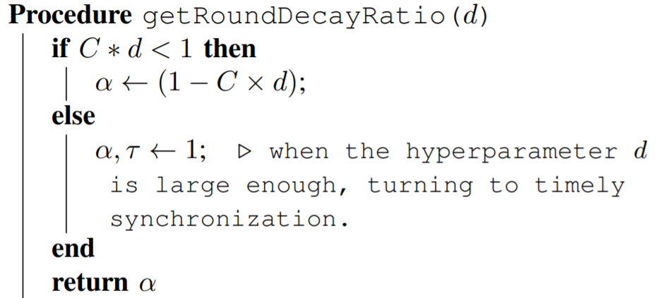
Algorithm
Q2
α (round-dimension)
β (iteration-dimension)
β <- iteration_id % synchronization_frquency

Slide 17
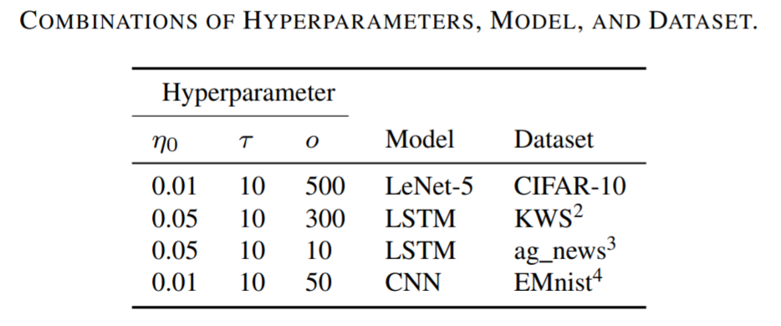
Evaluation
2D-LRD vs. FedAvg

Slide 18
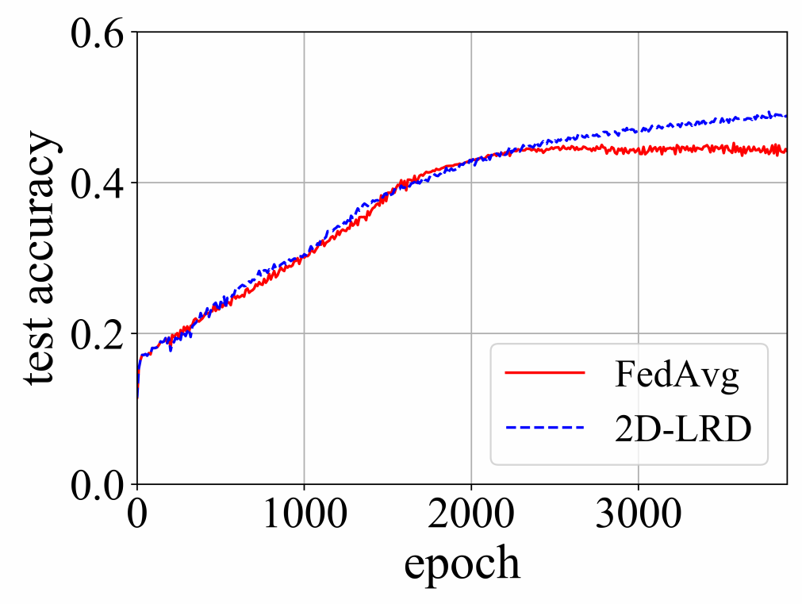
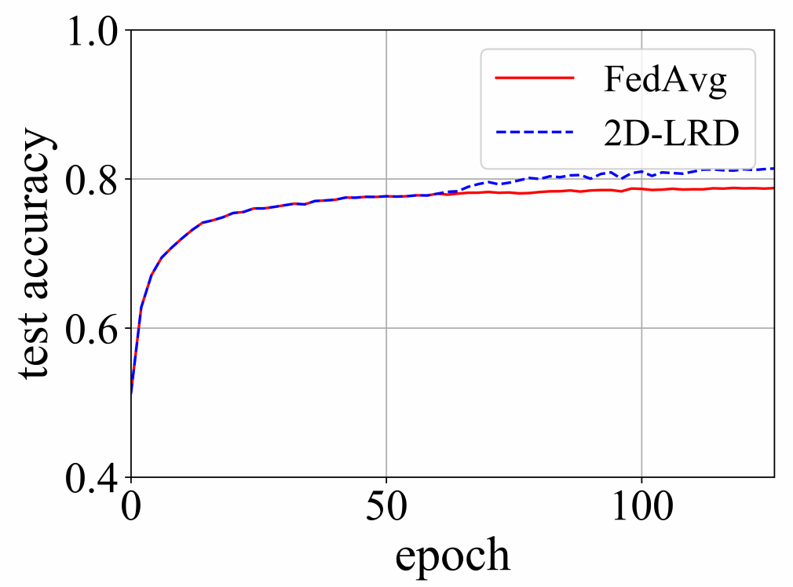
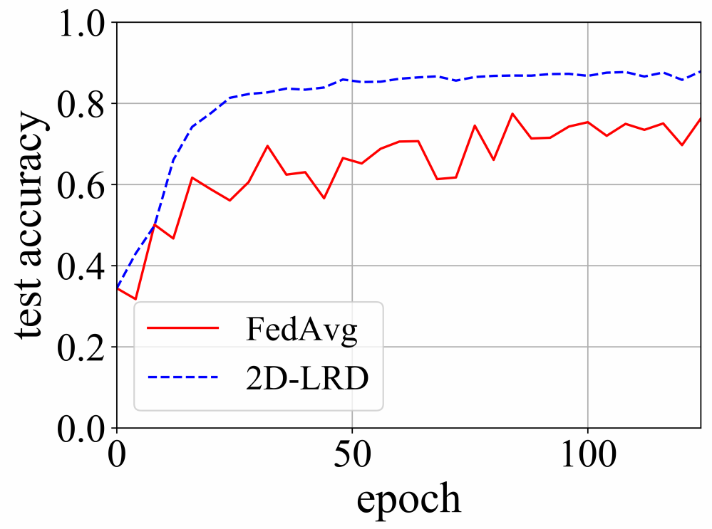
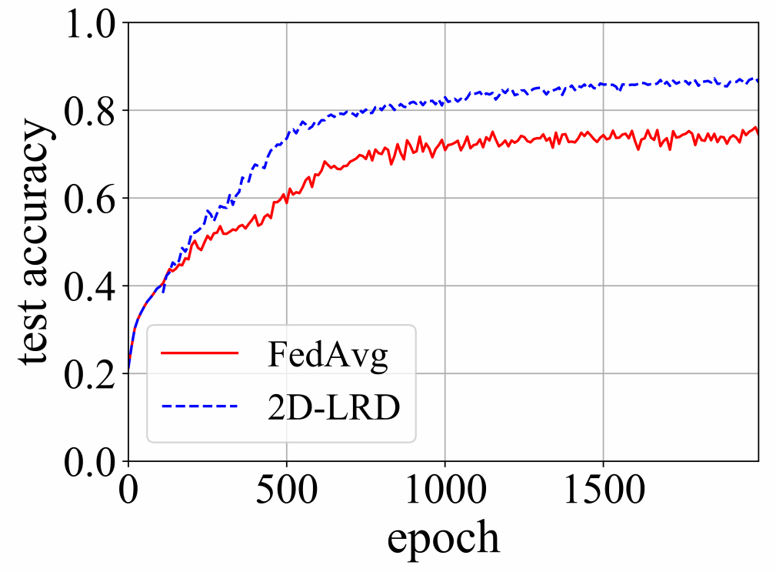
Evaluation
2D-LRD vs. FedAvg
Accuracy (%)
Data-set | Scheme
 | FedAvg | 2D-LRD
EMnist | 78.8 | 81.4
Cifar10 | 45.3 | 49.4
KWS | 76.1 | 87.4
ag_news | 76.3 | 87.9
(a) Cifar10
(b) EMnist
(c) ag_news
Fig. 4
(d) KWS

Slide 19
Evaluation
2D-LRD vs. AT & AD
Additive-Tuning (AT): Every time the model is entering stationary phase, the learning rate starting from the second iteration will be decreased by a decay value same as the round-dimensional decay in 2D-LRD.
All-Decreasing (AD): Every time the model is entering stationary phase, all the learning rates of local iterations will be multiplied by a decay coefficient. The decay coefficient is a constant.

Slide 20
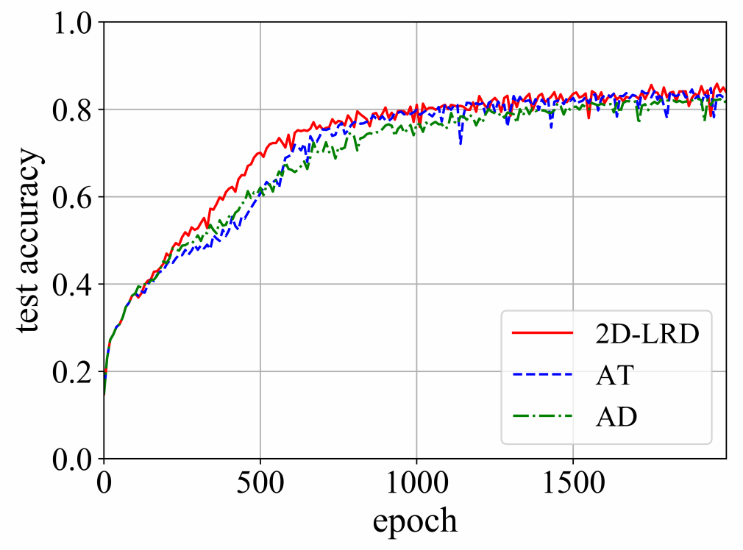
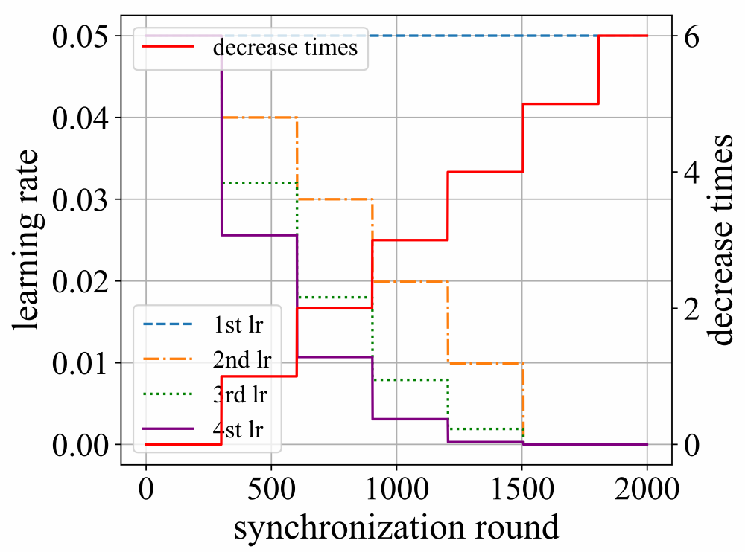
Evaluation
2D-LRD vs. AT & AD
Fig. 5 Accuracy under three schemes with KWS dataset, and the first four learning rates in a round under 2D-LRD.

Slide 21
Thanks
Contact: kaimo6-c@my.cityu.edu.hk

